Slide 1


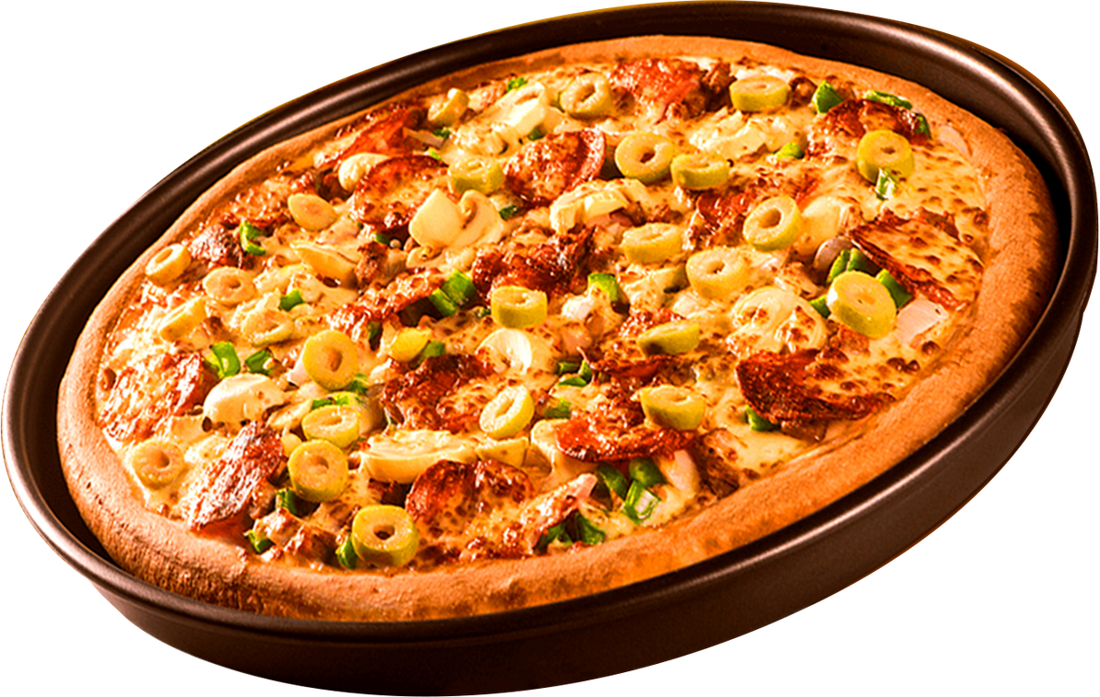


SQL PROJECT
PIZZA
HOUSE
SALES

Slide 2


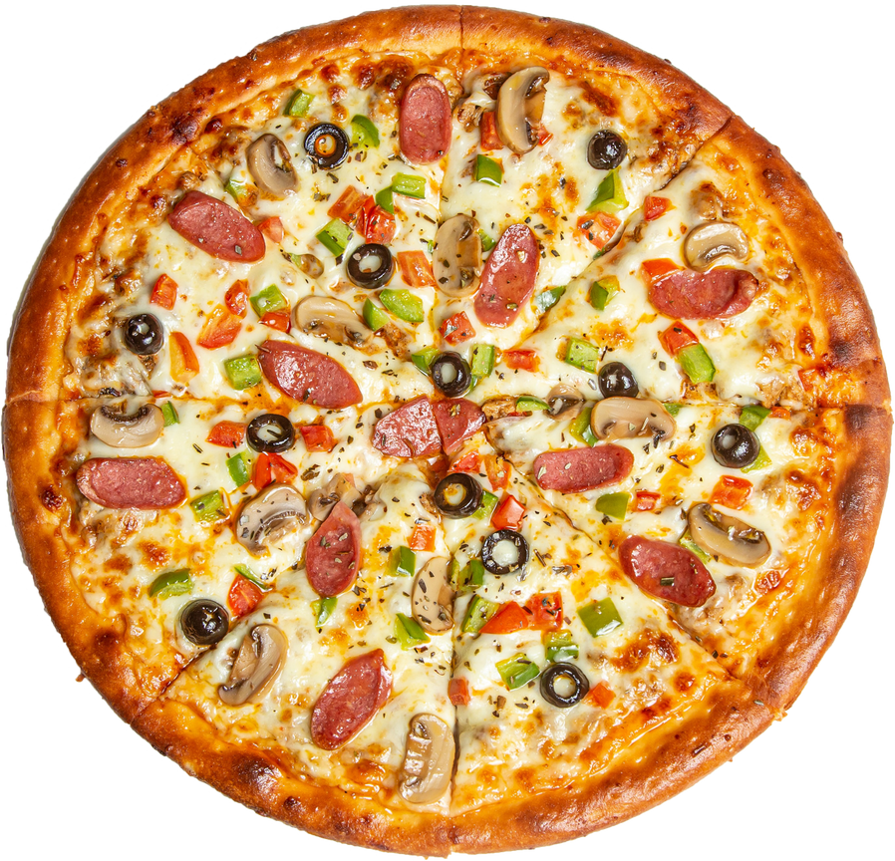


SQL
ABOUT PROJECT
This project analyzes pizza sales data using SQL to gain insights into customer behaviour, sales performance, and product popularity. The main objective is to help the business make data-driven decisions.

Slide 3


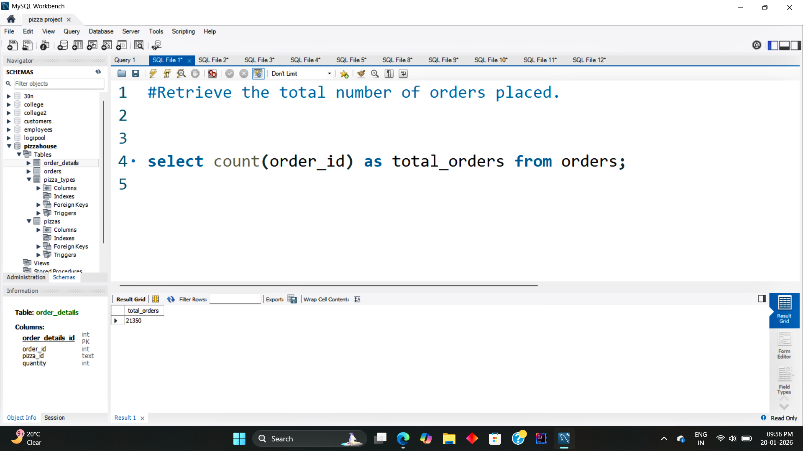

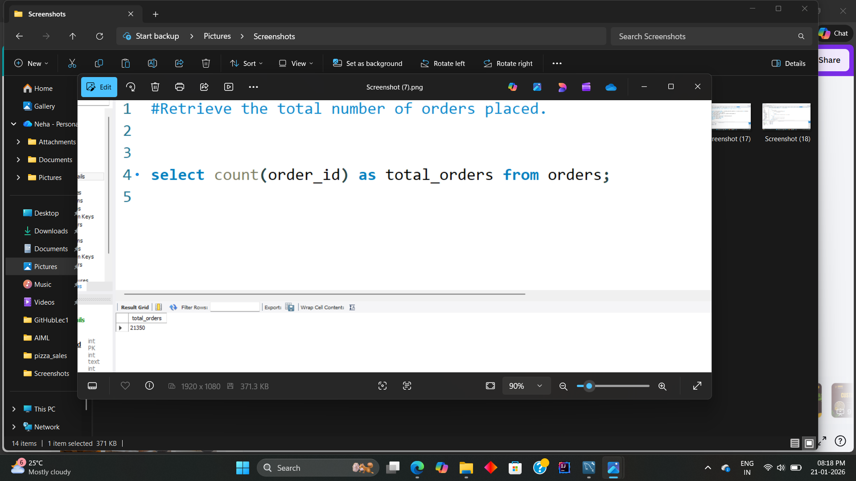
TOTAL NUMBER OF ORDERS PLACED
SQL
Pizza House

Slide 4
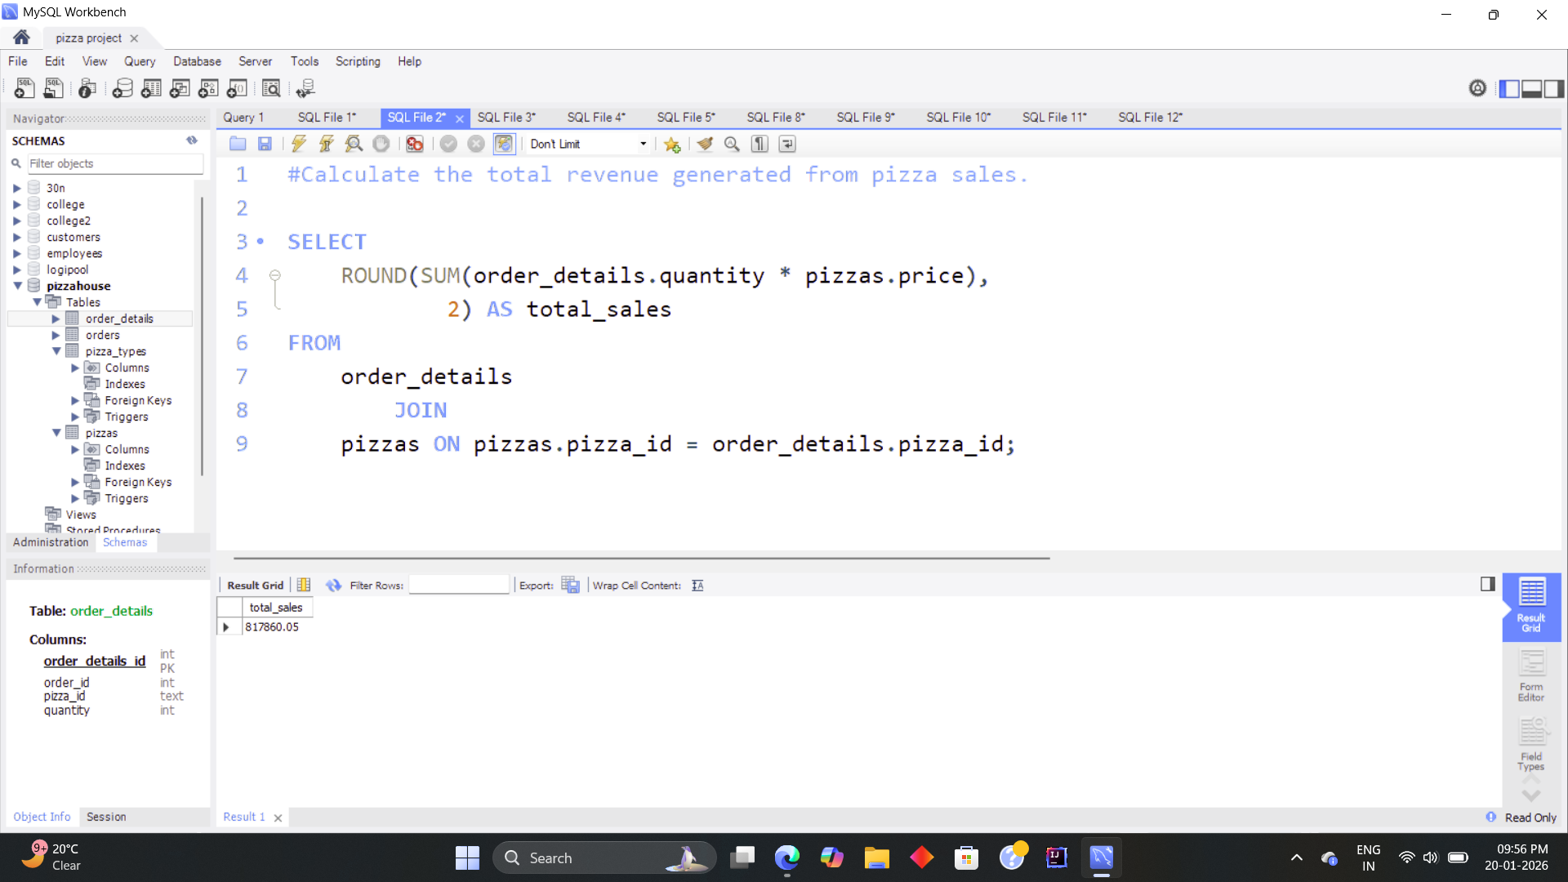
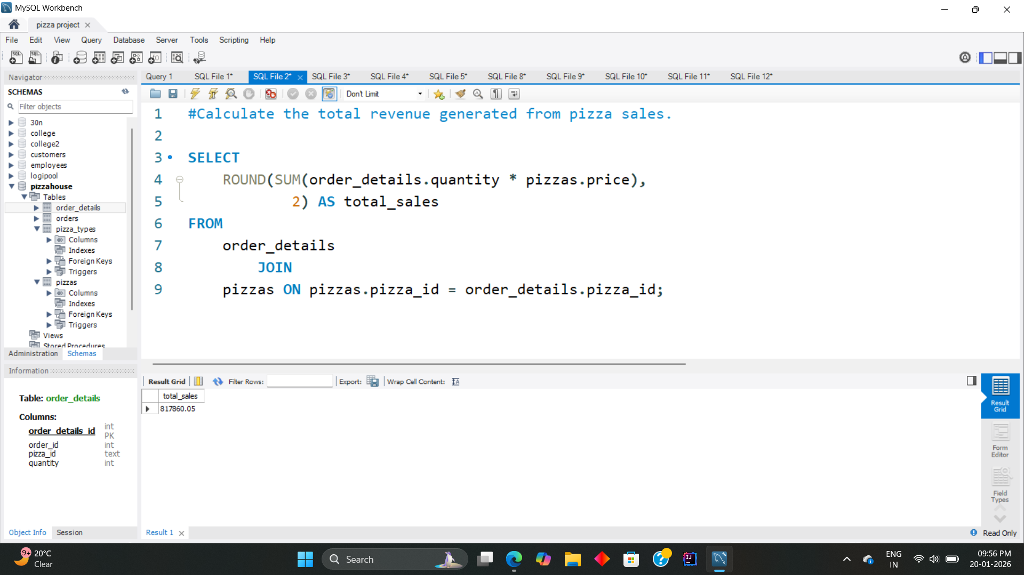
TOTAL REVENUE GENERATED FROM PIZZA SALES
SQL
Pizza House

Slide 5
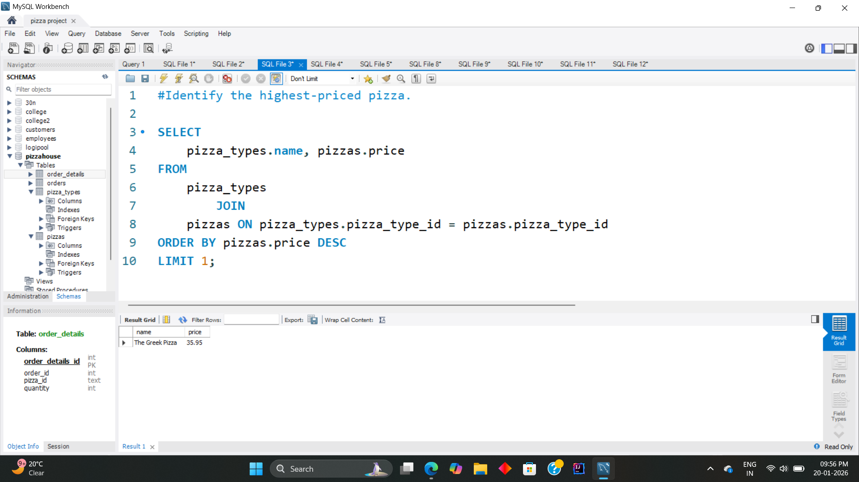
SQL
THE HIGHEST-PRICED PIZZA
Pizza House

Slide 6
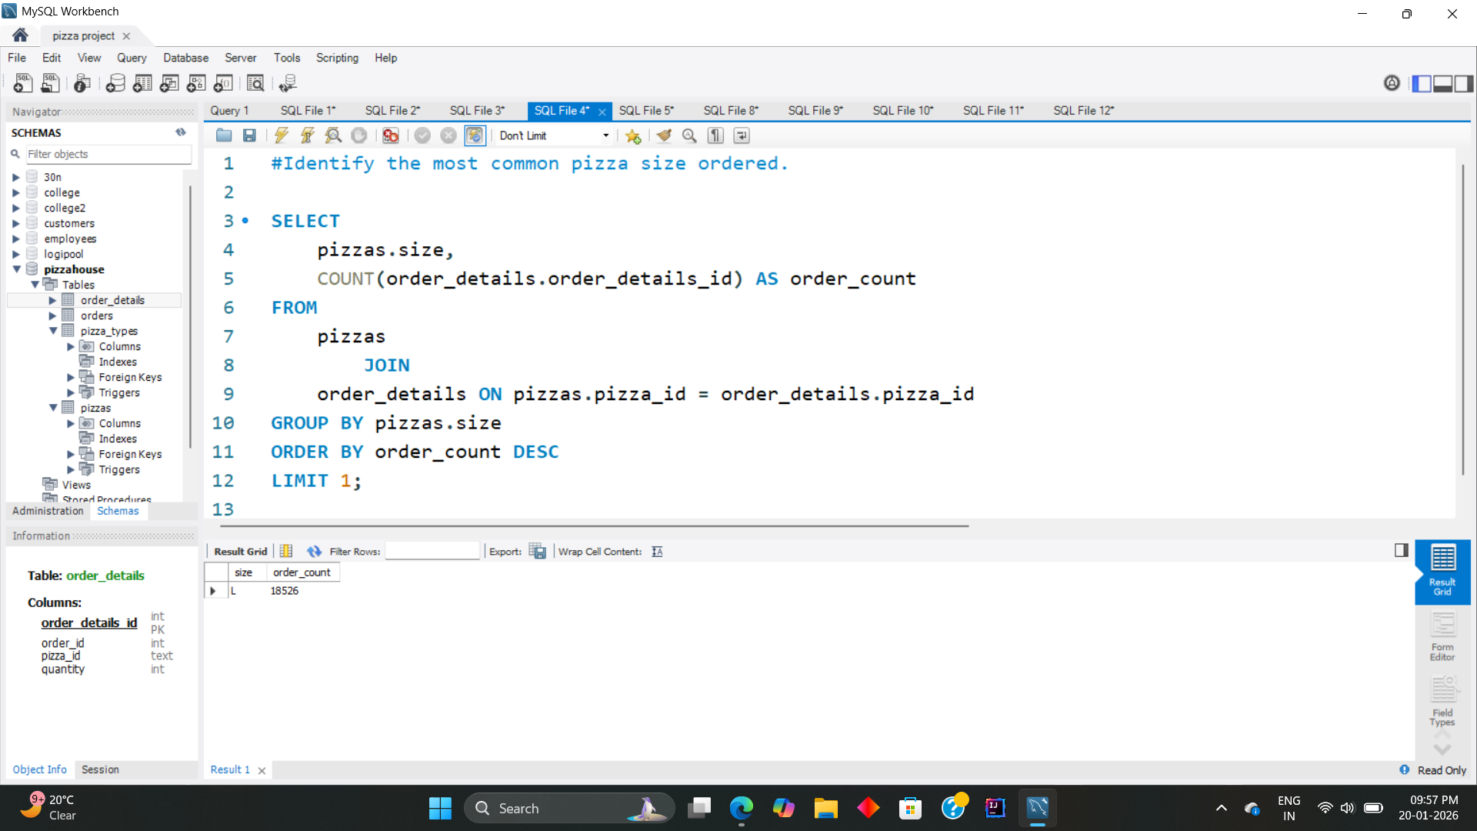
MOST COMMON PIZZA SIZE ORDERED
SQL
Pizza House

Slide 7
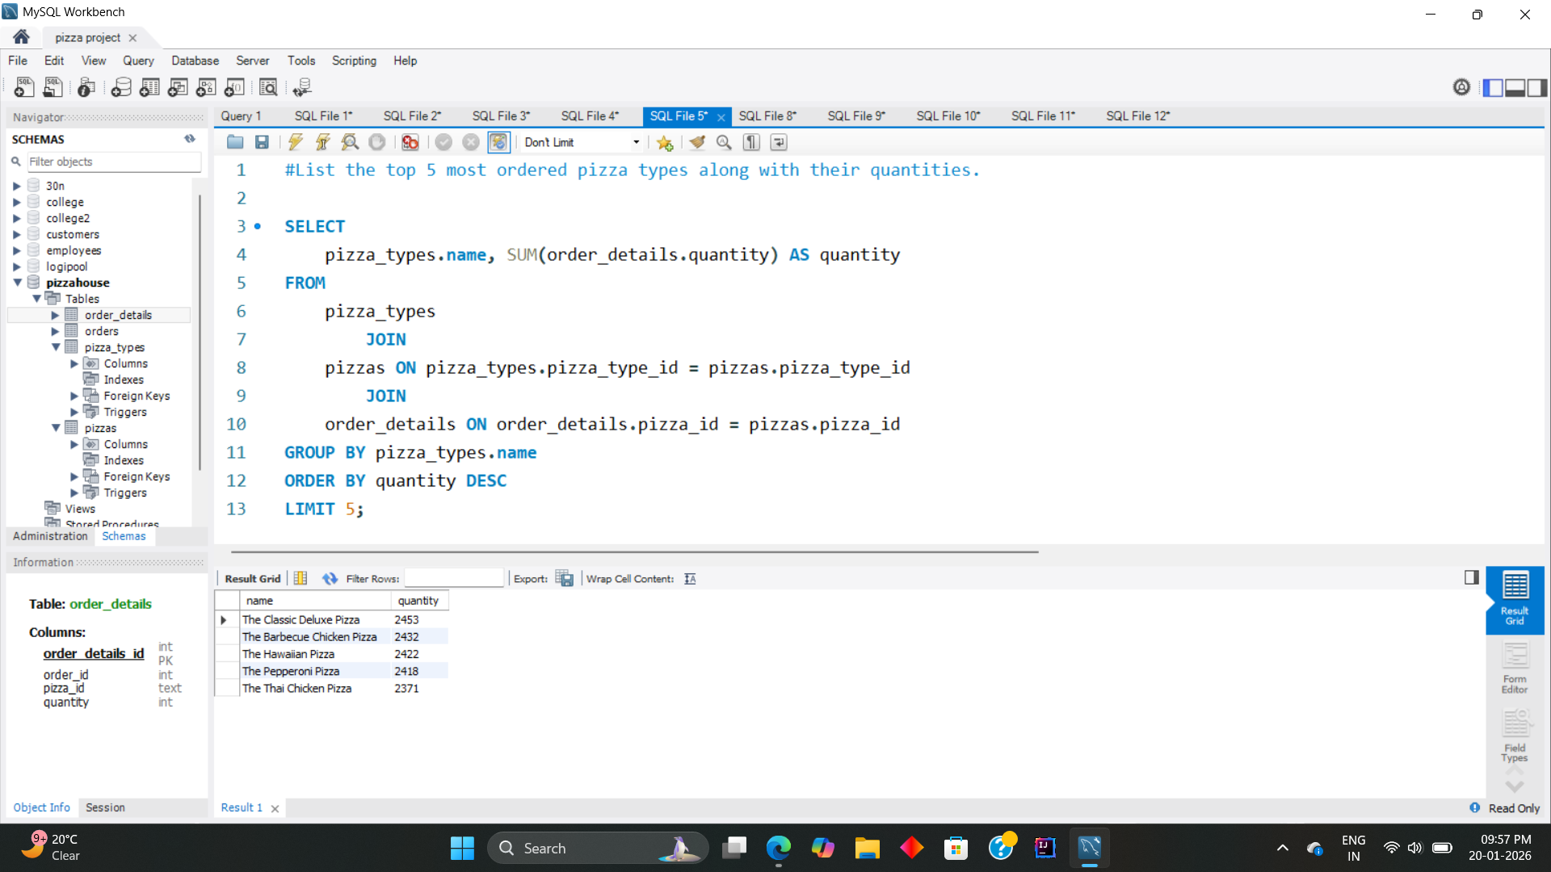
TOP 5 MOST ORDERED PIZZA TYPES ALONG WITH THEIR QUANTITIES
SQL
Pizza House

Slide 8
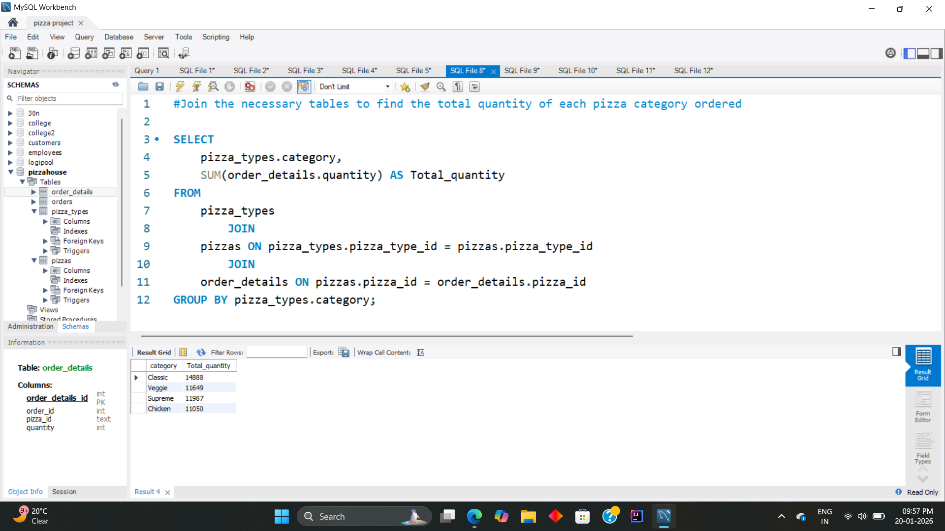
TOTAL QUANTITY OF EACH PIZZA CATEGORY ORDERED
SQL
Pizza House

Slide 9
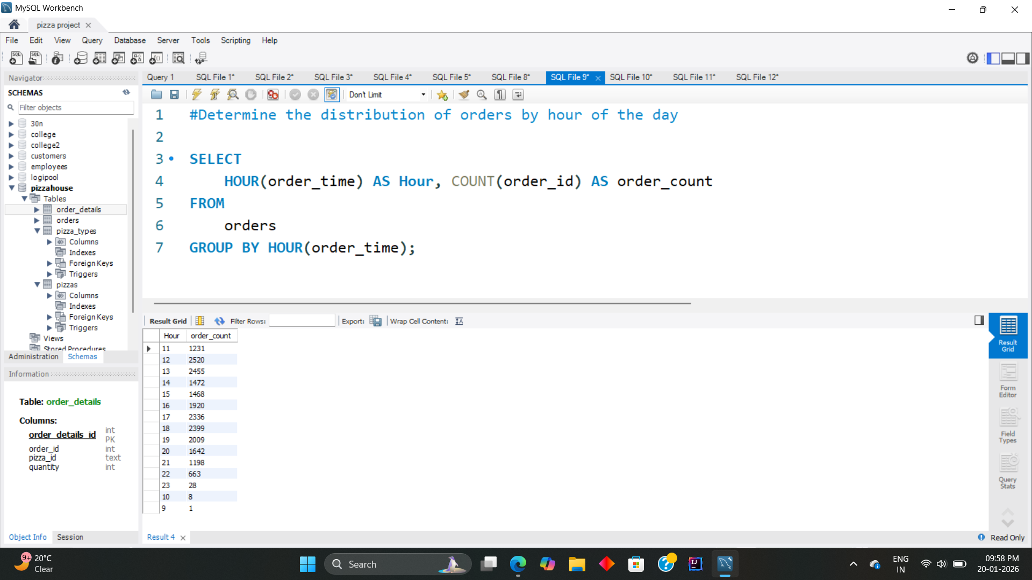
DISTRIBUTION OF ORDERS BY HOUR OF THE DAY
SQL
Pizza House

Slide 10
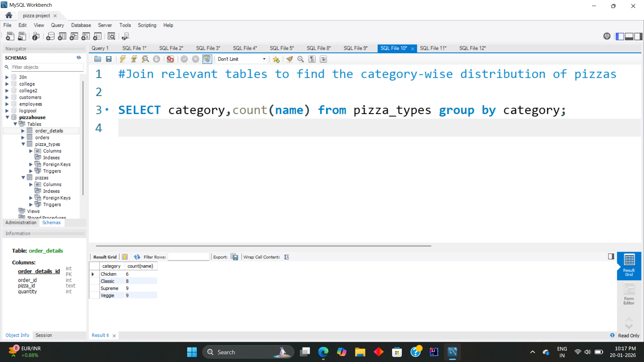
CATEGORY-WISE DISTRIBUTION OF PIZZAS
SQL
Pizza House

Slide 11
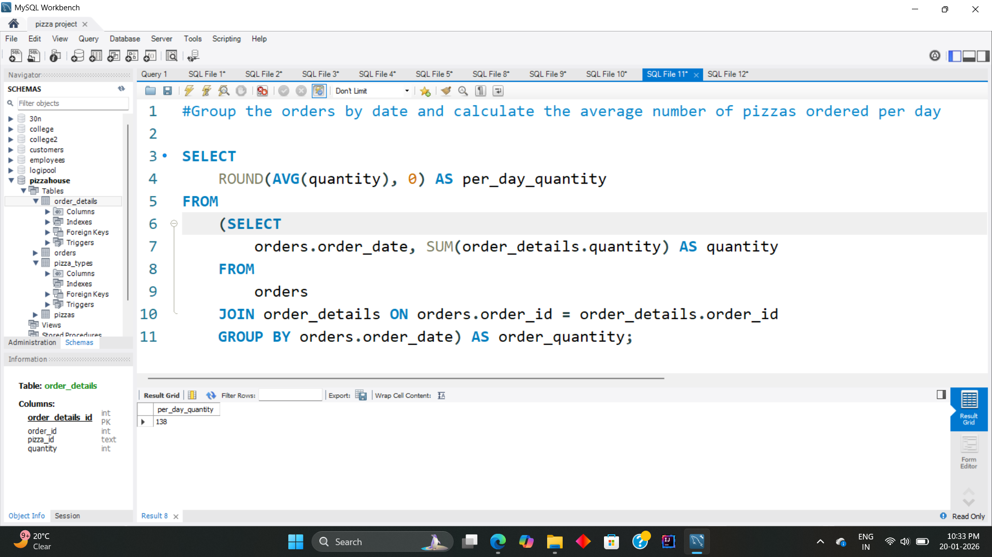
ORDERS BY DATE AND AVERAGE NUMBER OF PIZZAS ORDERED PER DAY
SQL
Pizza House

Slide 12
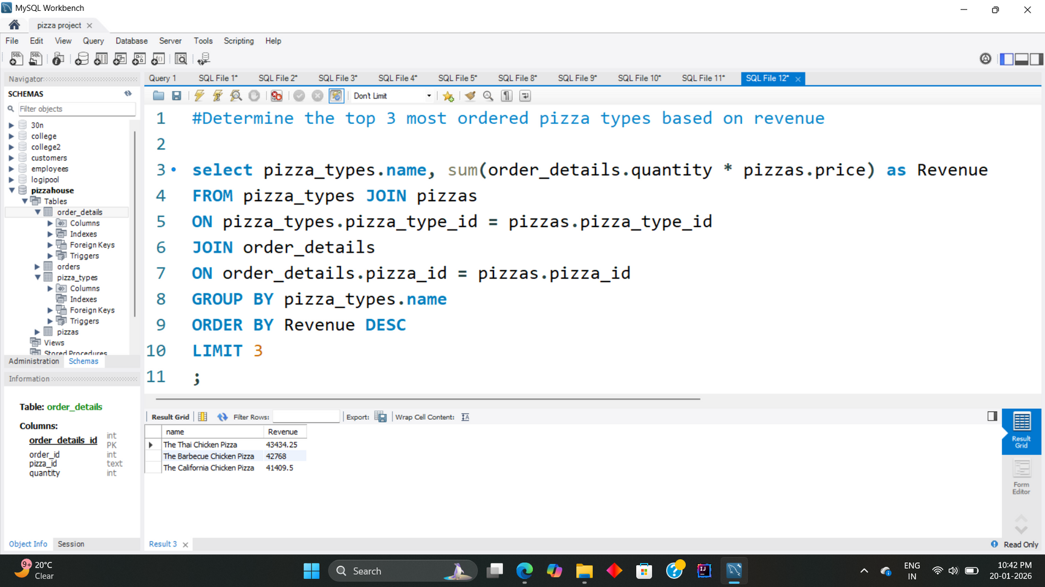

TOP 3 MOST ORDERED PIZZA TYPES BASED ON REVENUE
SQL
Pizza House

Slide 13
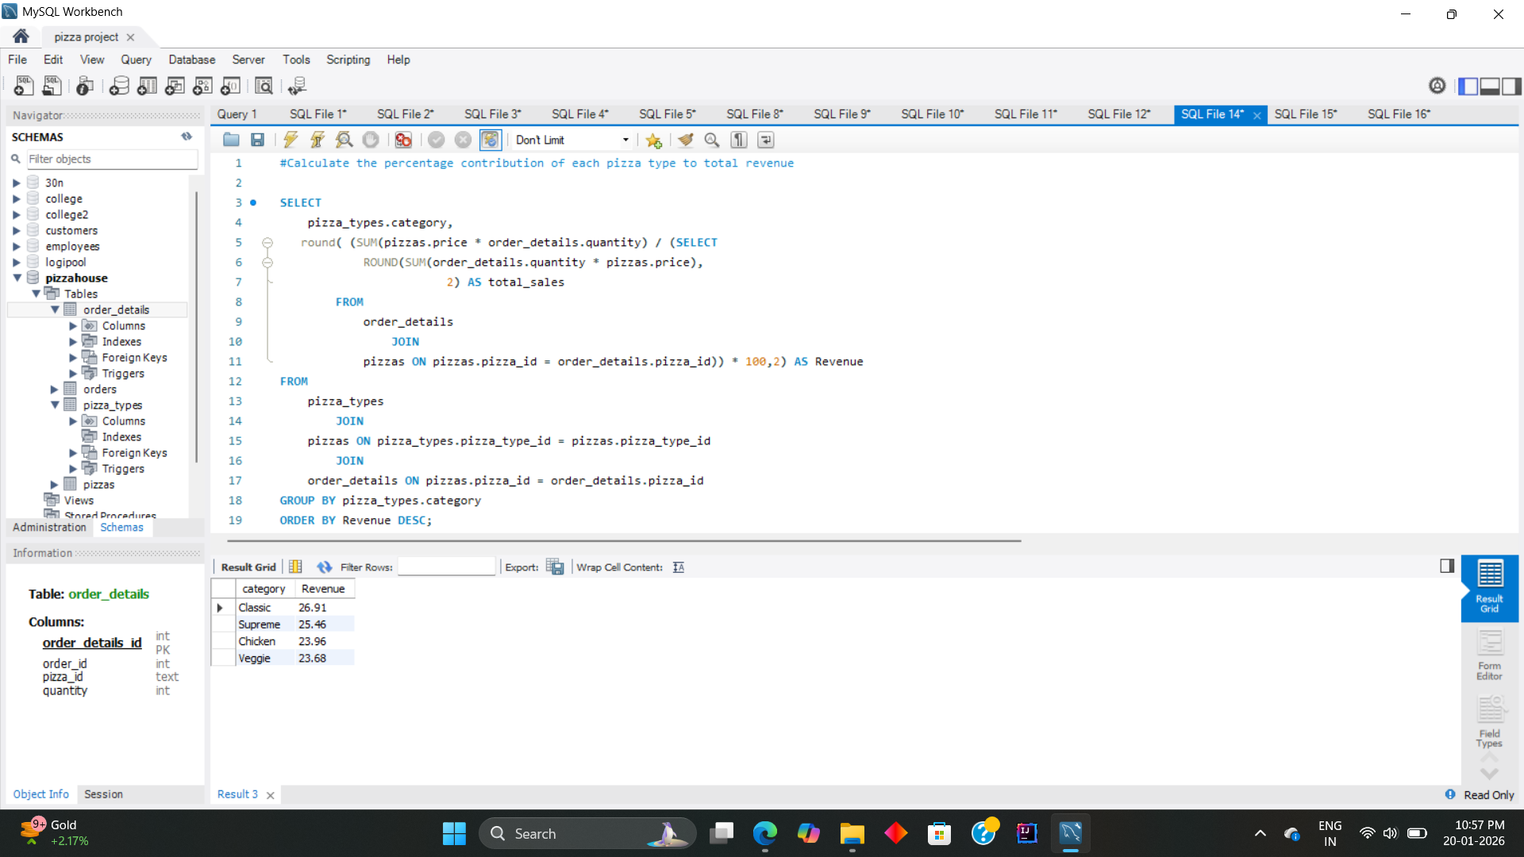
THE PERCENTAGE CONTRIBUTION OF EACH PIZZA TYPE TO TOTAL REVENUE
SQL
Pizza House

Slide 14
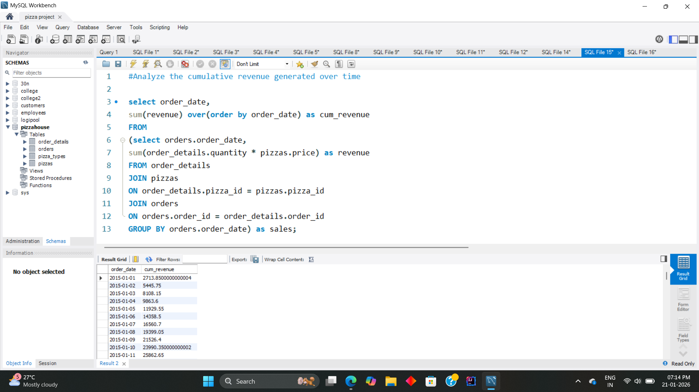
CUMULATIVE REVENUE GENERATED OVER TIME
SQL
Pizza House

Slide 15
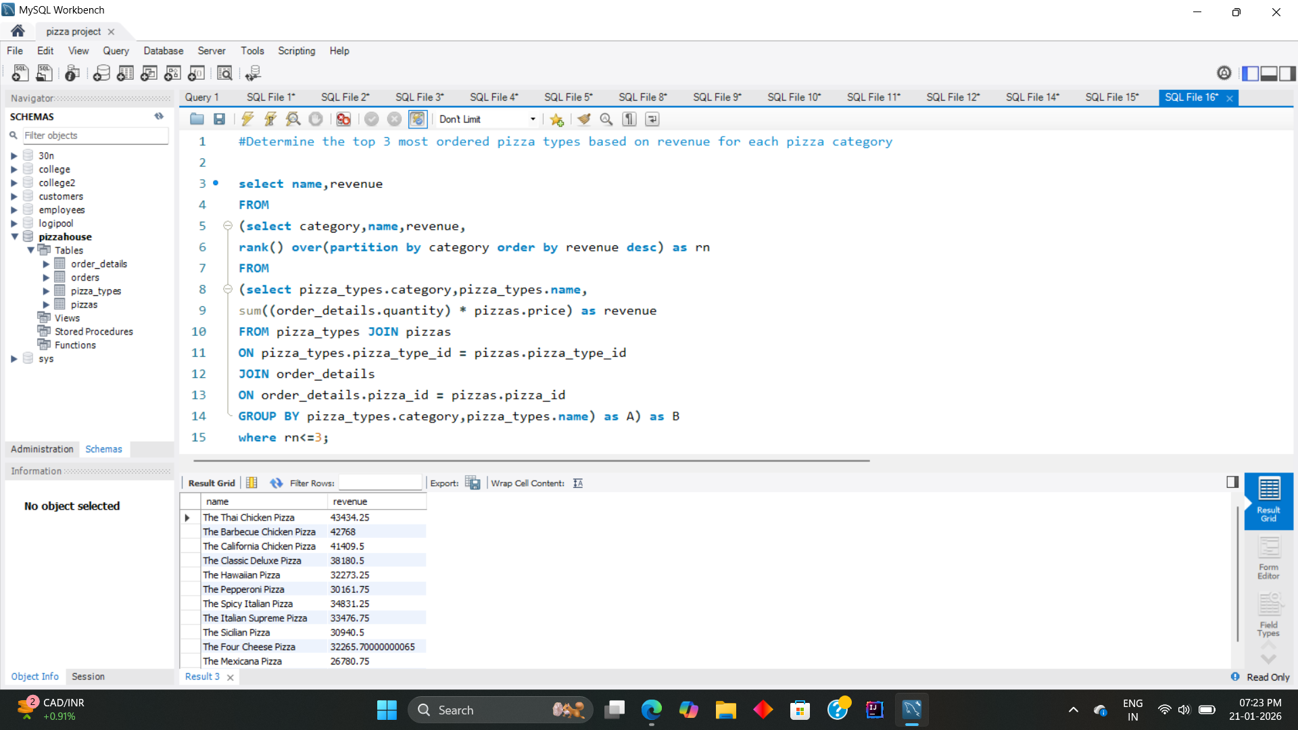
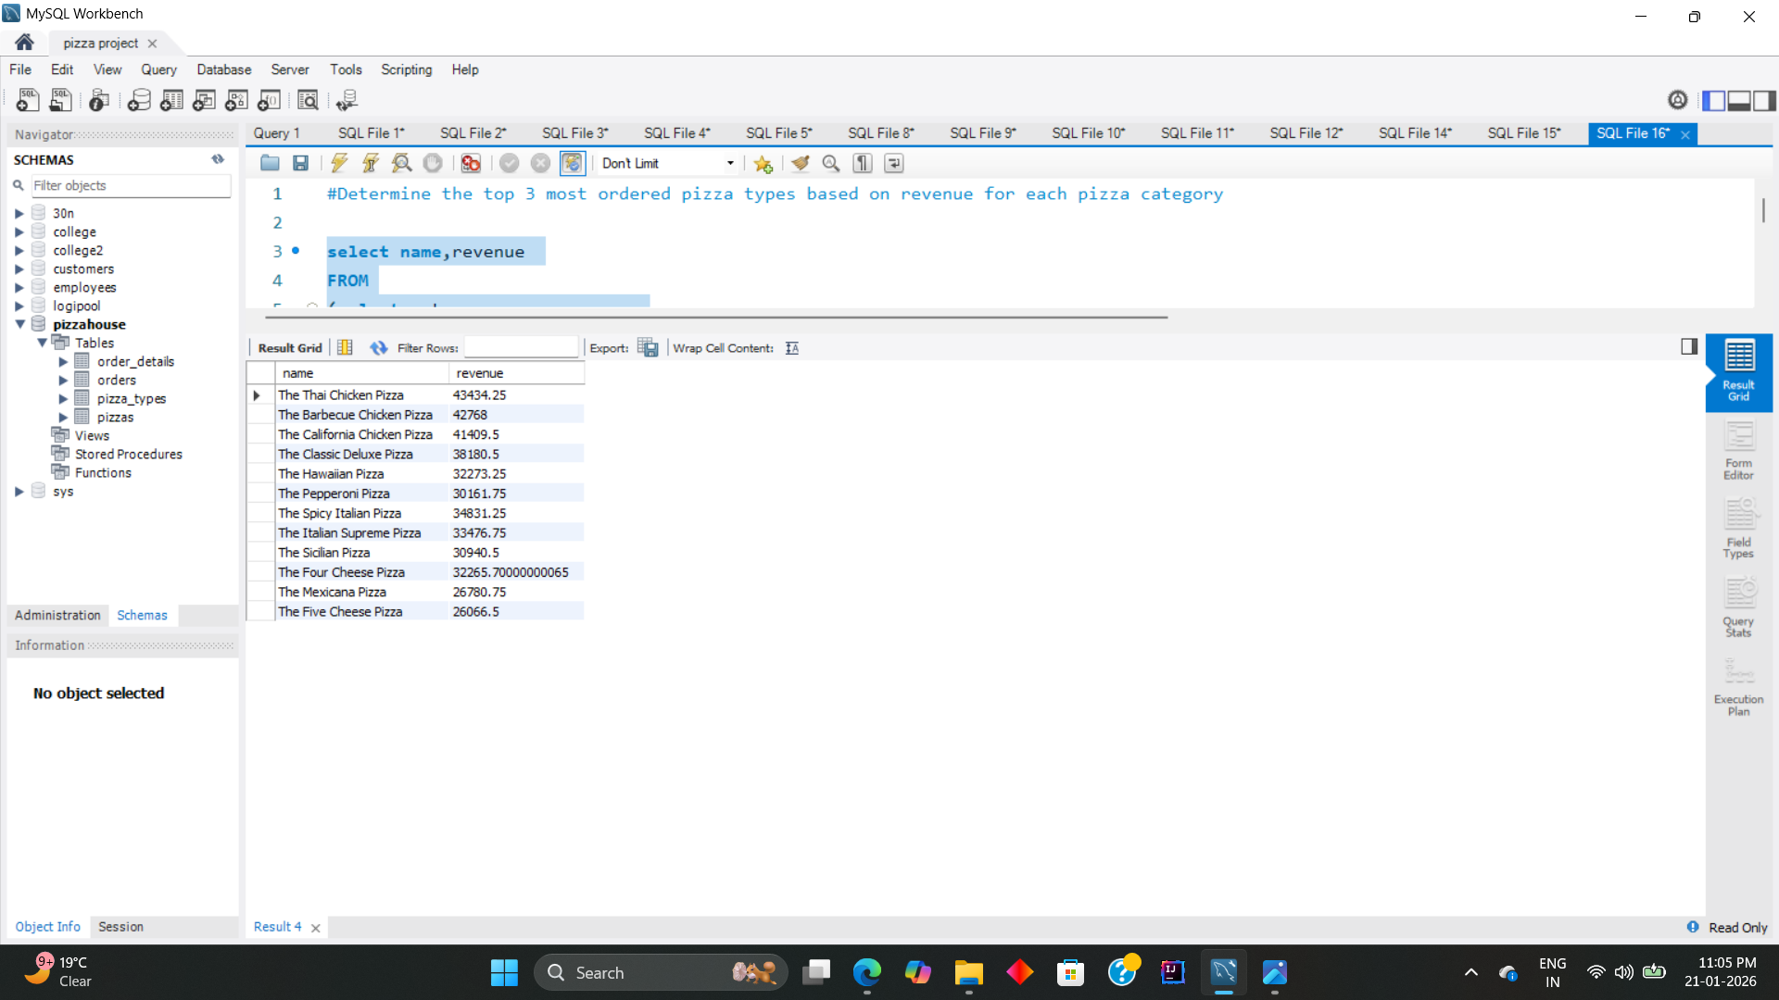
TOP 3 MOST ORDERED PIZZA TYPES BASED ON REVENUE FOR EACH PIZZA CATEGORY
SQL
Pizza House

Slide 16
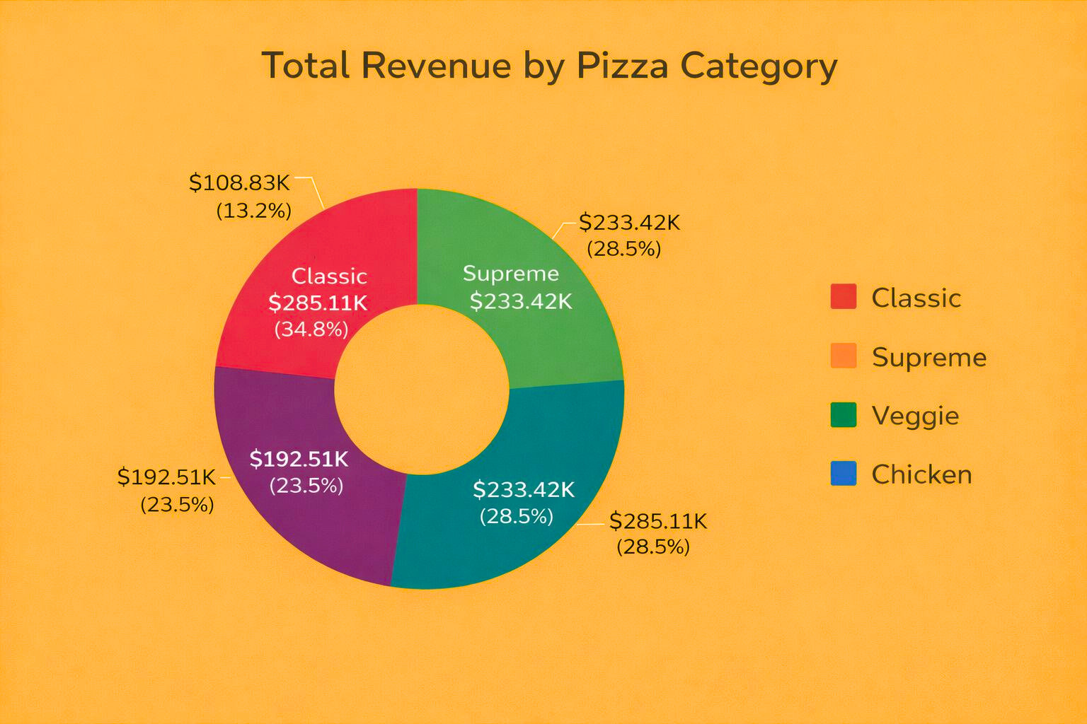
SQL
Pizza House
SALES REPORT
The pizza sales analysis reveals strong demand for classic and large sized pizzas, with peak ordering during lunch and dinner hours. Revenue is well-distributed across categories, providing multiple opportunities for targeted promotions and business growth.
Veggie
Chicken

Slide 17





SQL
Pizza House
THANK YOU

